Slide 1
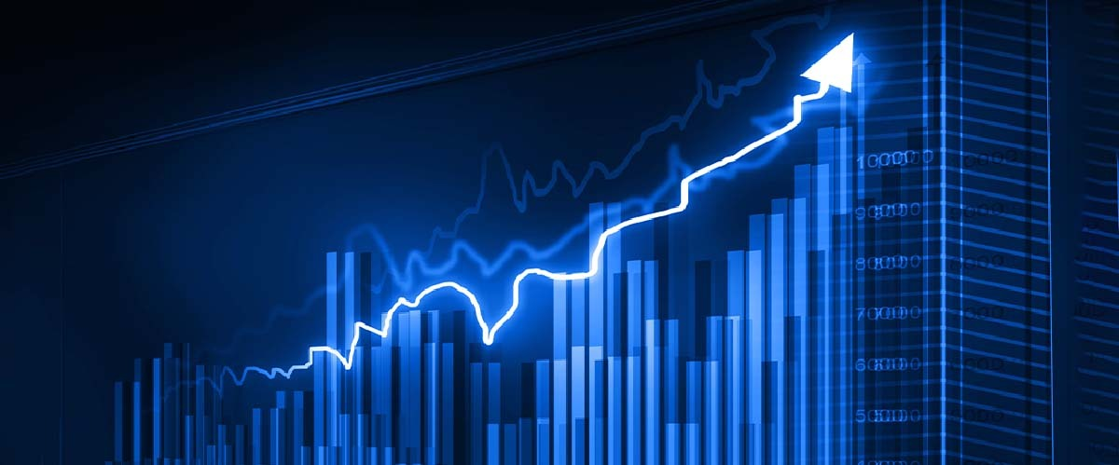
Reliance-Stock-Market-Prediction
Mentor:

Slide 2
Team Members:
Mr. CHAITANYA DIGAMBAR INGLE Mr.SHUBHAM SHASHIKANT PALKAR Mr. MADUGUNDU SAI KUMAR Mr. SHUBHAM VIJAY RANGATE Mr. PUGALENDHI S Ms. CHANDAKA APARNA

Slide 3

Business Objective of the project
The main objective of the project is to predict the stock prices of Reliance Industries Limited for the upcoming days. This involves obtaining essential stock data such as Open, High, Low, and Close prices, from 2015 to 2020. The project aims to identify short-term and long-term trends, analyze the impact of external factors and significant events, and provide a forecast for the next month.

Slide 4

Project Flow
-Data Collection
-Data Pre-processing
-Feature Selection
-Model Selection
-Model Training and Evaluation
-Model Deployment

Slide 5
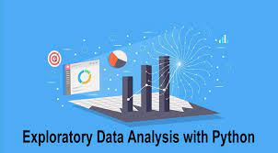
Exploratory Data Analysis (EDA)

Slide 6
Data set details
This data includes attributes such as:
Date: Date of trade
Open: Opening price of the stock
High: Highest price of the stock on that day
Low: Lowest price of the stock on that day
Close: Close price adjusted for splits
Adj Close: Adjusted close price adjusted for splits, dividends, and capital gain distributions
Volume: Volume of stock traded on that day

Slide 7
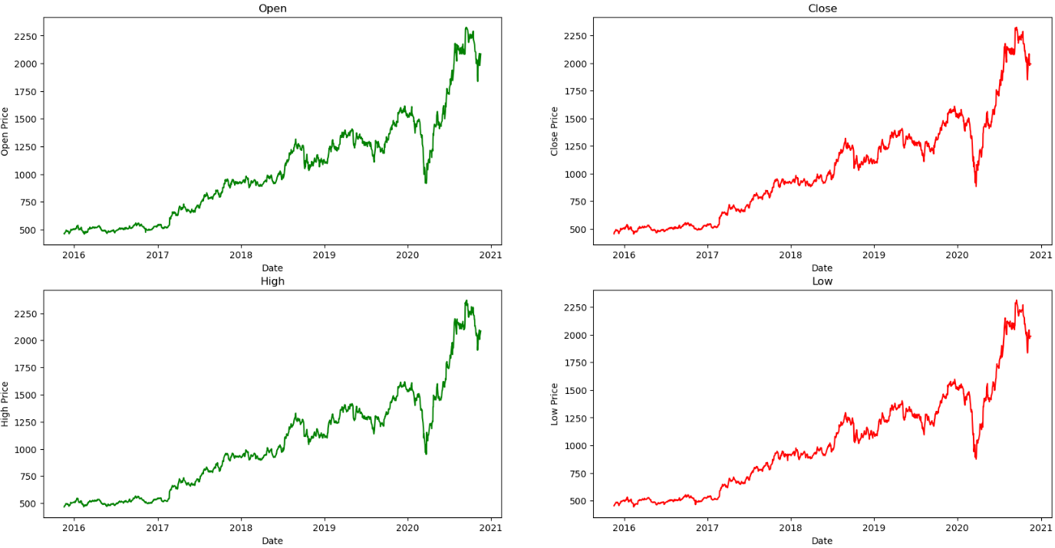
Line-Plot
The above graph is the raw data without any processes .
The X-axis represents Date .Y-axis represents the open price, close price, high price, low price, columns.
From below graph we can understand fluctuations of stock price.

Slide 8
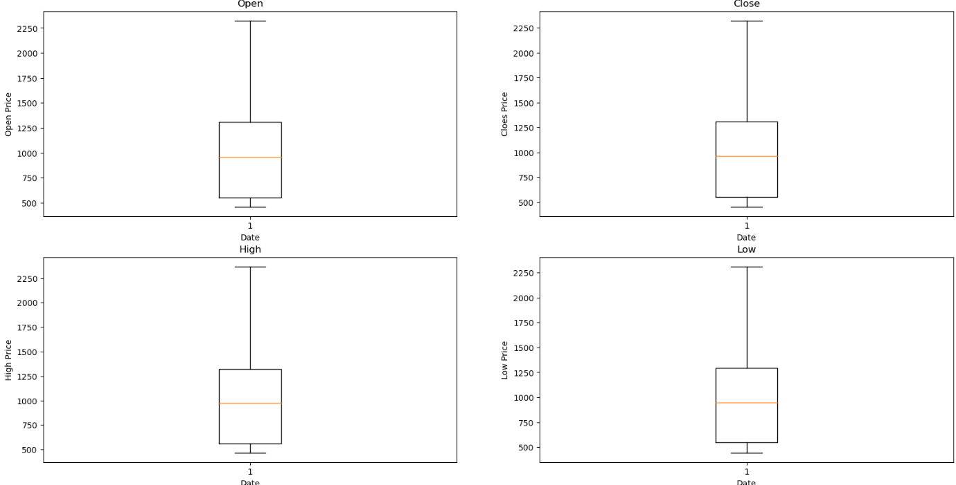
Box-Plot
From this graph we come to know about there is no outliers.

Slide 9
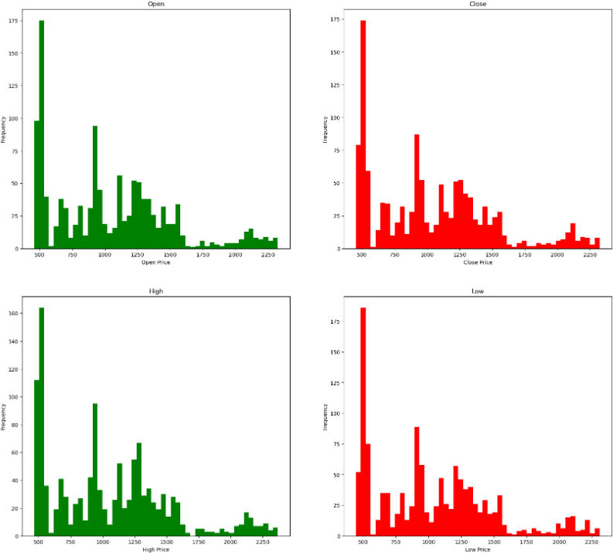
Histogram
Each showing the distribution of prices (Open, Close, High, Low) from the 'reliance' Data Frame with a specified number of bins and different colors.
From below graph we can understand frequency of prices.

Slide 10
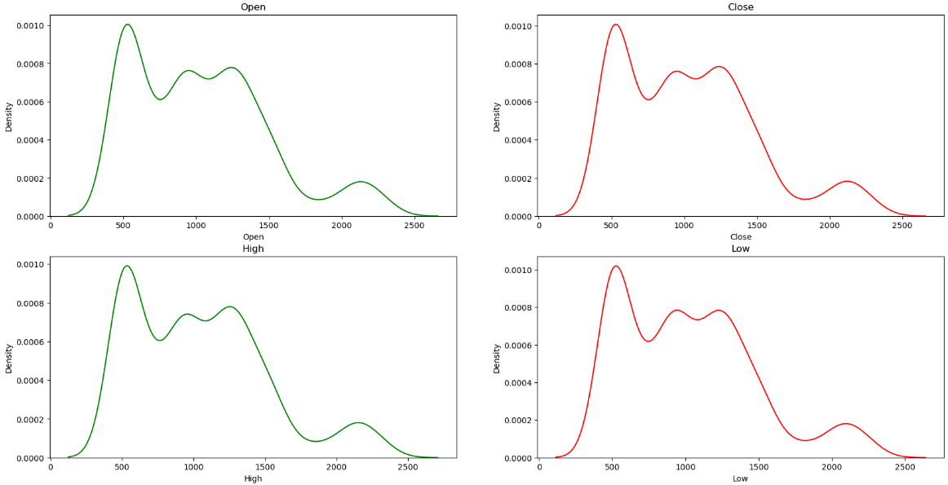
KDE-Plot
KDE plots are a valuable tool for exploring and understanding the distribution of continuous data, comparing distributions, and making data-driven decisions in various fields such as statistics, data science, and machine learning.
From below graph we can understand frequency of prices.

Slide 11
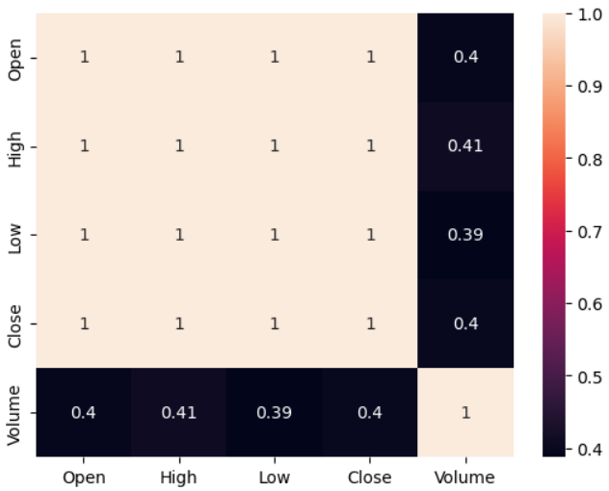
Correlation
Interpreting the heat map will help you understand the relationships between variables in dataset.
From below graph we can understand High price and volume having high correlation.

Slide 12
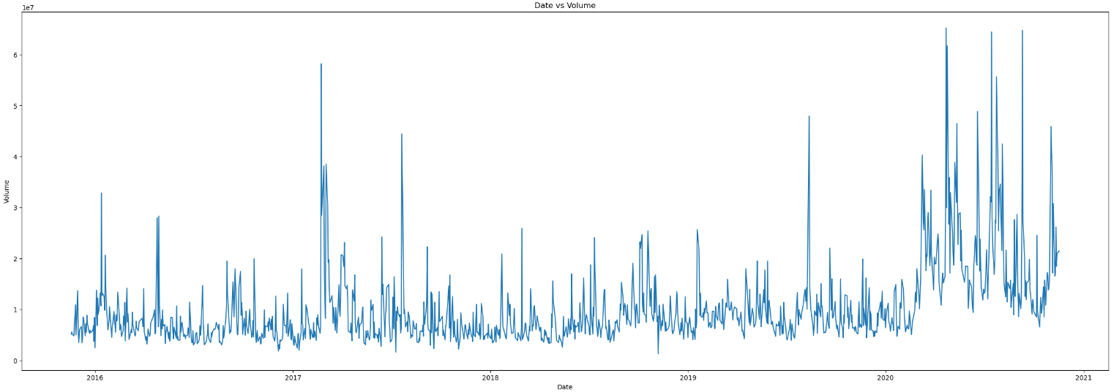
Line-Plot
From below graph we can understand stock was increased in 2021.

Slide 13
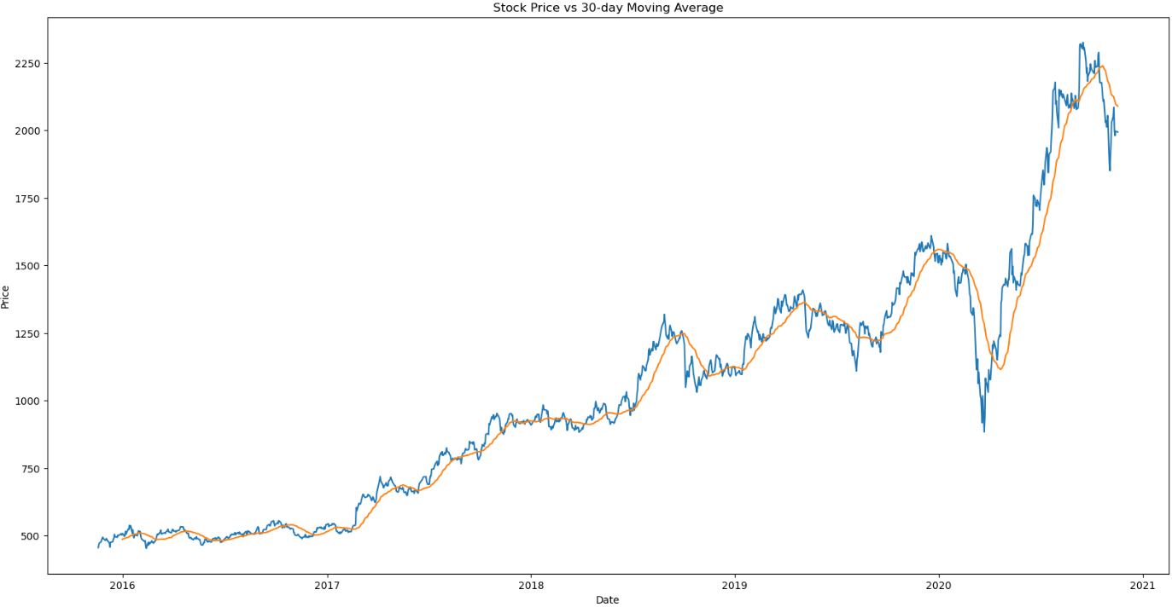
Long Term Moving Average
A moving average chart is a valuable tool for smoothing out data and revealing underlying trends and patterns
Form the below graph stock price vs 30-day moving average. In this graph we are observe fluctuations of stock at 30-day
Its long term trend. In middle of the 2021 stock price was increased.

Slide 14
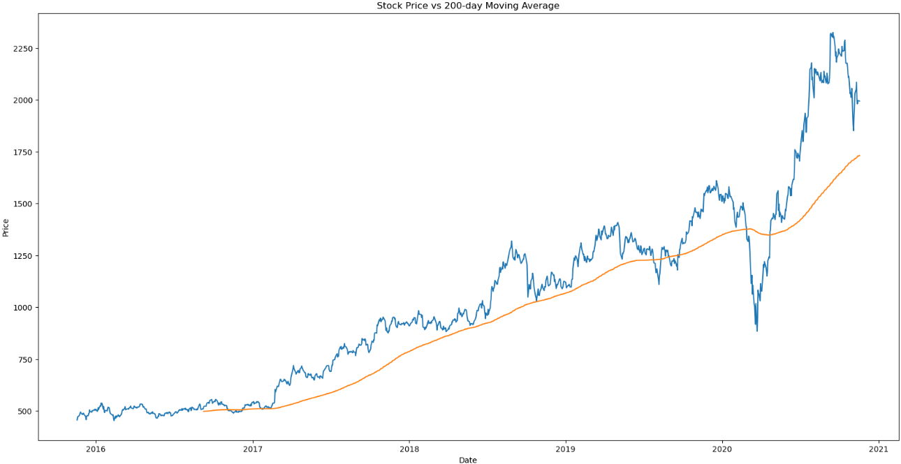
Short Term Moving Average
Form the below graph stock price vs 200-day moving average. In this graph we are observe fluctuations of stock at 200-day
Its short term trend. 2017 to 2021 gradually increased .

Slide 15

Model Building

Slide 16
Model Used:
Support Vector Regression
Random Forest Regression - RF
K-Nearest Neighbors – KNN
LSTM
GRU (Gated Recurrent Unit)

Slide 17
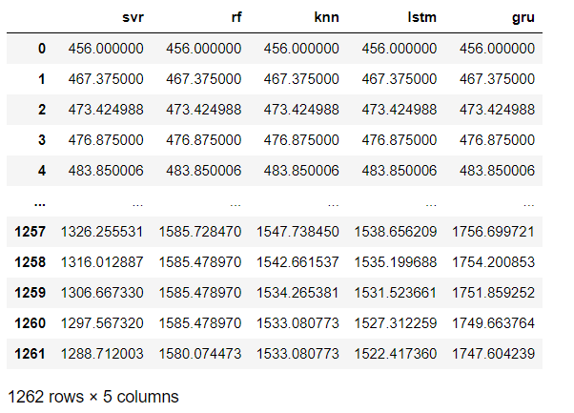
Model results-Data set

Slide 18
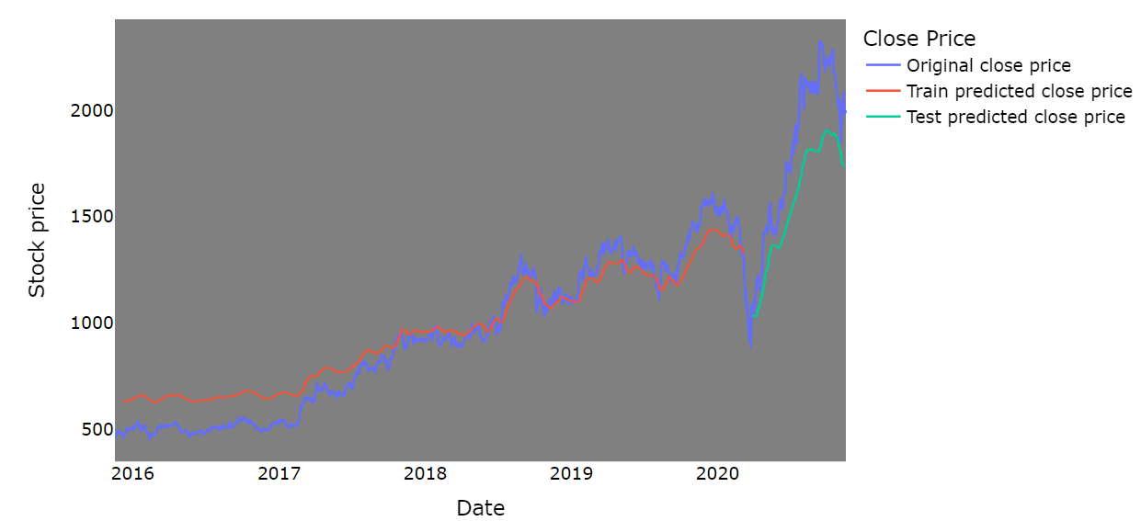

SVR-Comparison between original stock close price vs predicted close price

Slide 19
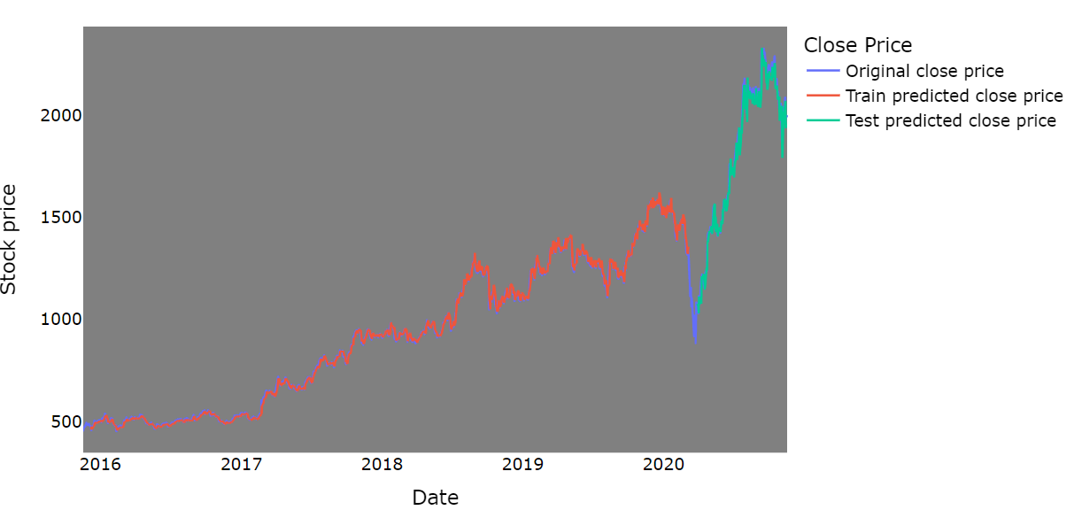

RF-Comparison between original stock close price vs predicted close price

Slide 20
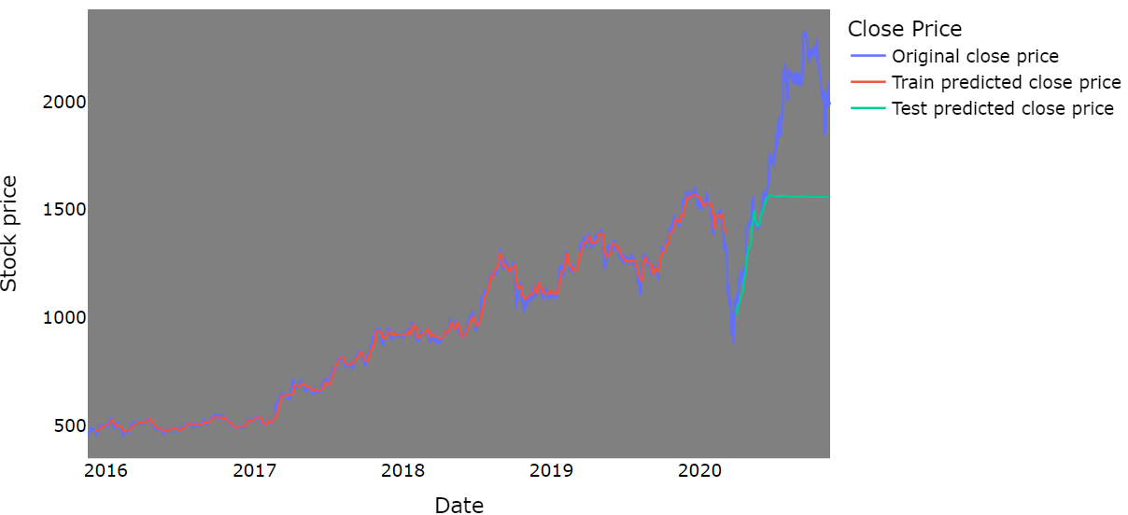

KNN-Comparison between original stock close price vs predicted close price

Slide 21
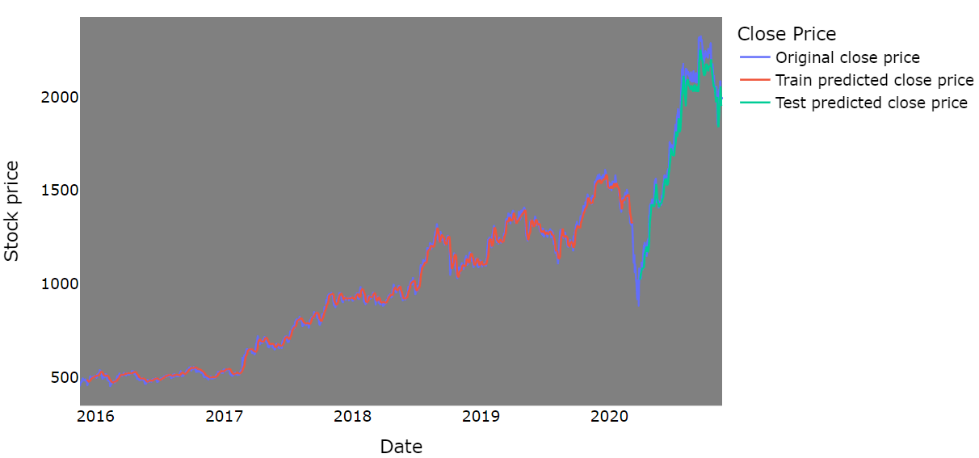

LSTM-Comparison between original stock close price vs predicted close price

Slide 22
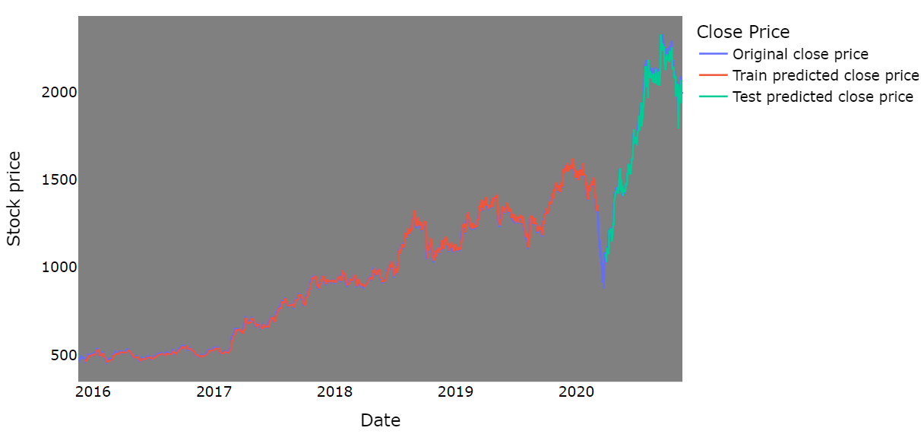

GRU-Comparison between original stock close price vs predicted close price

Slide 23
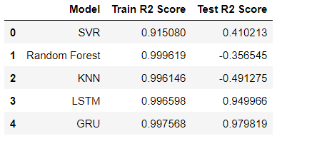
Model result
By Looking into this table we can say that our LSTM model have best R2 score.

Slide 24
Model Results
For final model, LSTM.
We have deployed our model using LSTM.
It is giving R2score is 0.99%.
We have use STREAMLIT for deployment.
We are taking Reliance dataset as input.
And Output will be predict customers to get the stock price hike and decrease in stock prices to invest in particular stocks..

Slide 25
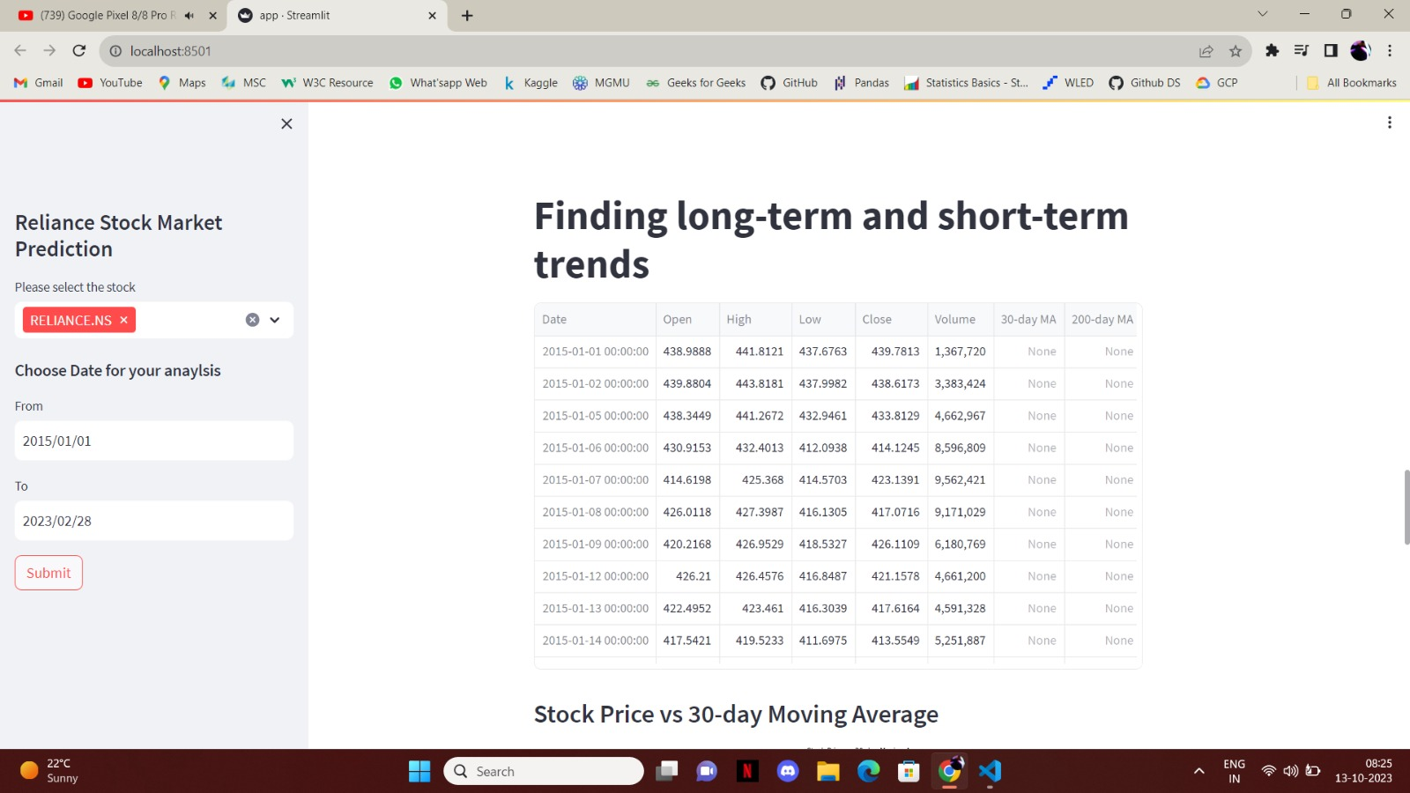
Model Deployment using STREAMLIT

Slide 26
Thank You
.

